Slide 1

Mississippi ARPA/SLFRF
Update for DMO and Mainstreets
April 14, 2026
House Bill(HB) 1571 Legislative Update
and Final Phase of ARPA Funds

Slide 2
HB 1571 Legislative Changes
ARPA funds are subject to recoupment by the Department of Finance and Administration (DFA) at any time, if
  An organization fails to submit an approved report; or
  An organization fails to report any expenditures in two consecutive required reports
Requires all ARPA invoices to be paid by September 30, 2026

Slide 3
Key Dates:
In order to meet
HB 1571 Legislative Deadlines
April 15, 2026 – Notification letter (if required) uploaded to the DFA portal
April 16, 2026 – DFA will begin contacting any entities who anticipate having any remaining funds
August 31, 2026 – Date all invoices must be paid
September 10, 2026 – Final expenditure report filed for all invoices
September 18, 2026 – Date repayment of outstanding funds must be postmarked to DFA

Slide 4
ARPA Additional Information
Per 31 USC 3324, services or goods must be received before payment. Therefore, invoices cannot be paid for services that have not been received and goods that have not come into your possession
Funds are not considered expended until all reports are approved. Please make all corrections quickly once reports are returned in the portal. Funds that are not correctly reported are subject to recoupment
Per HB 1571, if you have remaining funds and have not submitted an approved report OR reported any expenditures in two consecutive months, the remaining funds are subject to recoupment. Please notify us of all delays
Monthly reporting must continue until all funds are expended
If your entity has funds to return to DFA, please contact CRI as soon as possible

Slide 5
Final Phase of ARPA Funds
Notification Letter
Annual Federal Funding Questionnaire
Close Out Procedures

Slide 6
Notification Letter - Due April 15, 2026
If you have funds remaining, you must submit the notification letter for each round of ARPA funds you accepted
Sign the form and upload the form to the DFA reporting portal
Organizations must enter the anticipated amount of invoices to be paid by August 31, 2026. The anticipated amount should be the total of all invoices to be paid from inception through August 31, 2026
If the anticipated amount of invoices to be paid by August 31, 2026 is less than the obligated funds, then there will be an amount to repay to DFA.

Slide 7
Notification Letter – Due April 15, 2026
DFA walkthrough of portal navigation of Notification Letter

Slide 8
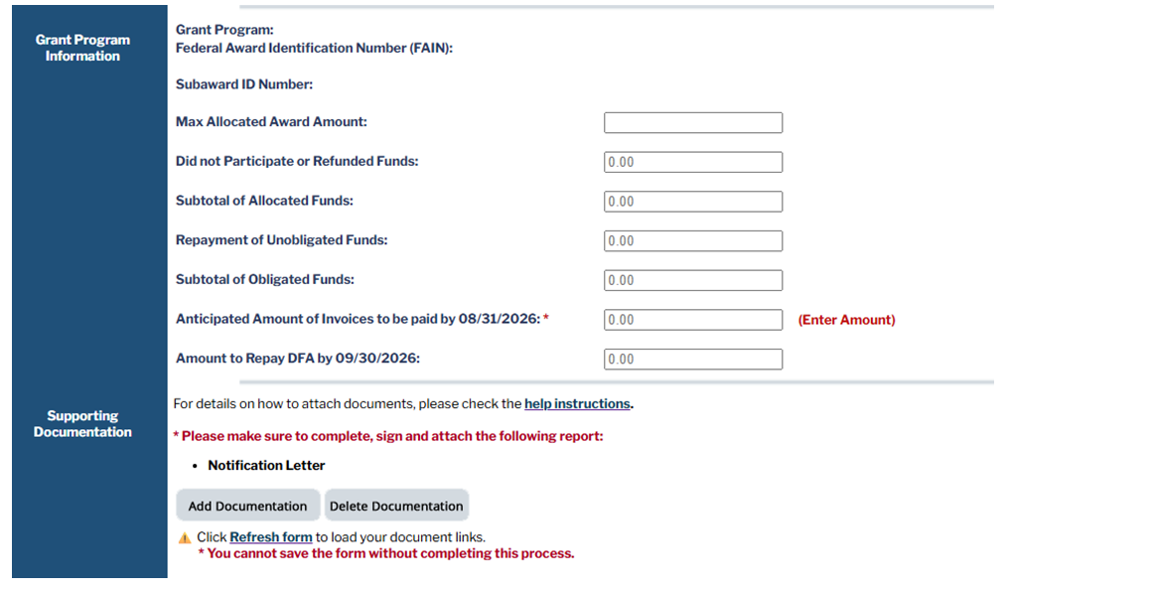
Notification Letter – Due April 15, 2026
Anticipated Amount of Invoices to be paid by 8/31/2026:
All of the fields will pre populate with your organizations information except for the anticipated amount of invoices to be paid by 8/31/2026
The only amount to enter is the Anticipated amount. The anticipated amount is the total of the amount of invoices that has been paid and the amount expect to be paid by 8/31/2026

Slide 9
Annual Federal Funding Questionnaire
The Annual Federal Funding Questionnaire should be completed for each year that the organization had expended funds
  In other words, if the organization has reported expenditures on the payroll or nonpayroll expenditure form for Round 1 and/or Round 2 for 2023 through 2026, then there should be 4 Annual Federal Funding Questionnaires completed and uploaded (ARPA funds are federal funds and these funds were passed through to your organization from the State by DFA)
Annual Federal Funding Questionnaire form and instructions are included in documentation and templates section of DFA portal
If the Annual Federal Funding Questionnaire form indicates the organization had over $750,000 or $1,000,000 depending on the fiscal year, then a single audit should have been performed and the report must be uploaded to the portal

Slide 10
Annual Federal Funding Questionnaire
DFA walkthrough of Annual Federal Funding Questionnaire in Portal

Slide 11
Close Out Procedures
Organizations that have expended all of the ARPA funds AND completed the Annual Federal Funding Questionnaire should complete the close out documentation for each round of only after approval of the Annual Federal Funding Questionnaire
Organizations will not have access to the close out documentation section if the Annual Federal Funding Questionnaire has not been approved.
All close out procedures must be performed and approved to be considered completed

Slide 12
Close Out Procedures
DFA walkthrough of portal navigation Close Out Procedures

Slide 13
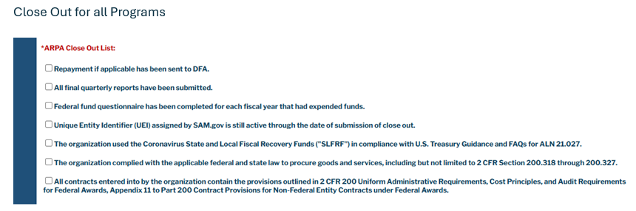
Close Out Procedures

Slide 14
Mississippi ARPA/SLFRF
Update for DMO and Mainstreets
  QUESTIONS?

